Slide 1
DAMG 6210 Project Data Vizualization in Tableau
File created on: 4/11/23 7:18:52 PM EDT

Slide 2
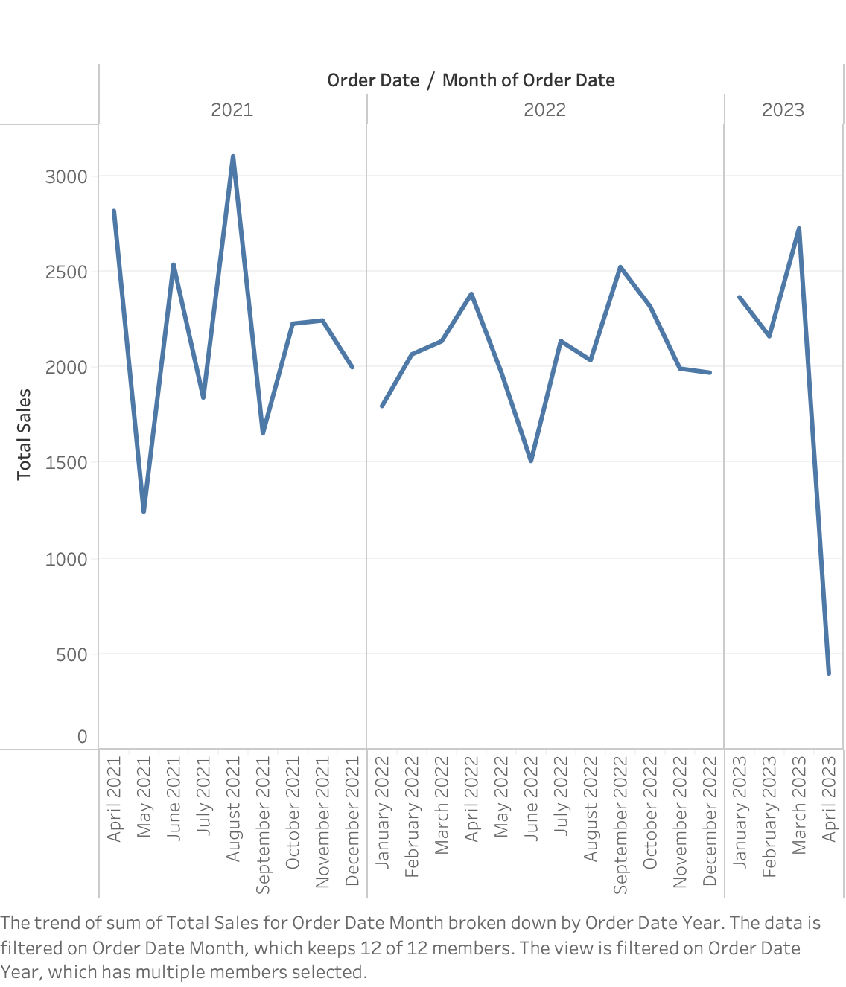

Slide 3
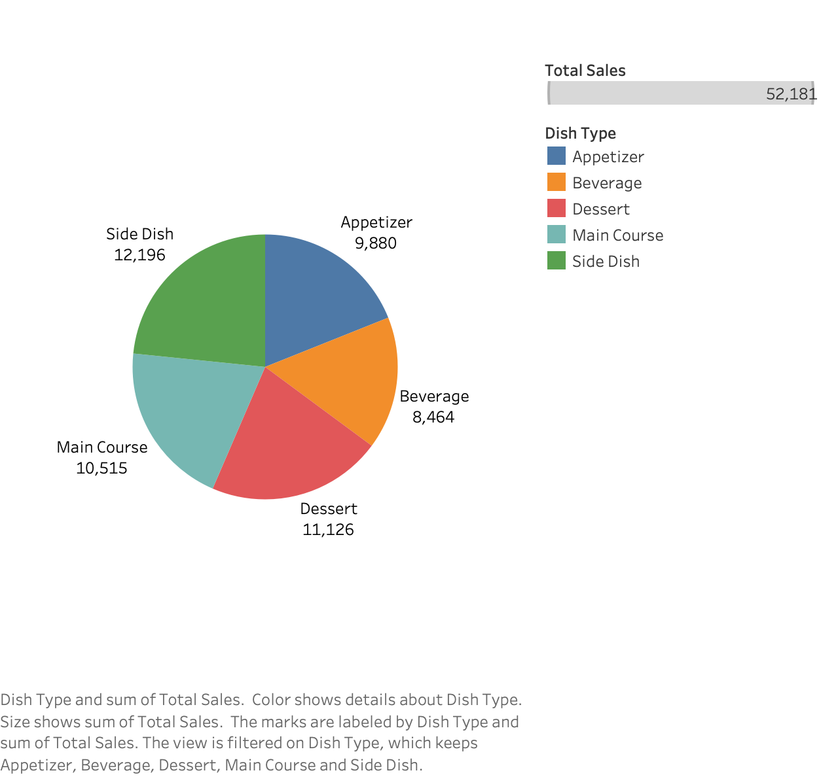

Slide 4
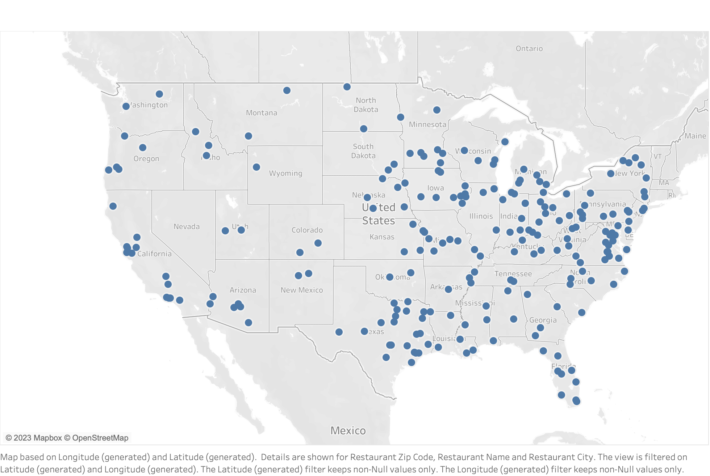

Slide 5
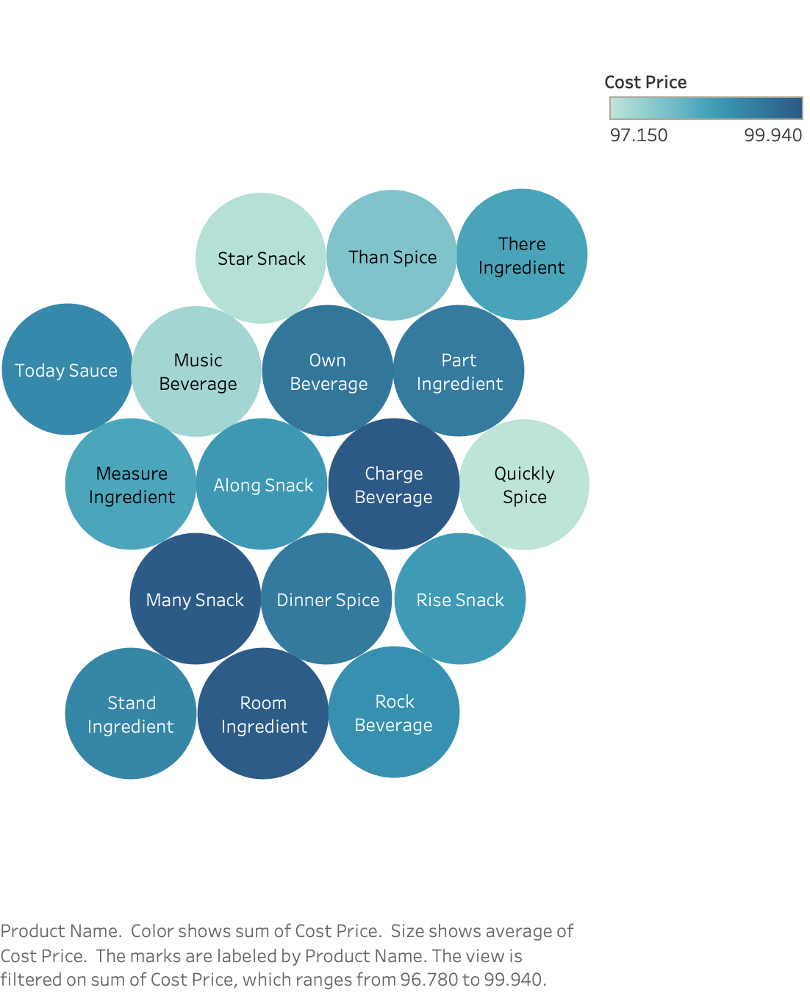

Slide 6
